Slide 1
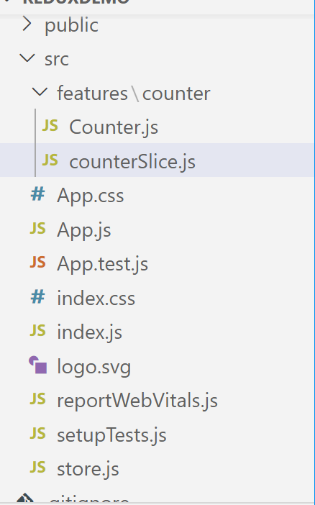
File name: Counter.js
File name: counterSlice.js
Above file is in src\feature\counter folder

Slide 2
import { createSlice } from '@reduxjs/toolkit'
export const counterSlice = createSlice({
name: 'counter',
initialState: {
value: 0 },
reducers: {
increment: state => {
state.value += 1
},
decrement: state => {
state.value -= 1
},
incrementByAmount: (state, action) => {
state.value += action.payload
}
}
})
export const selectCount = (state) => state.counter.value
// Action creators are generated for each case reducer function
export const { increment, decrement, incrementByAmount } = counterSlice.actions
export default counterSlice.reducer
File name: counterSlice.js
// Redux Toolkit allows us to write "mutating" logic in reducers. It
// doesn't actually mutate the state because it uses the Immer library,
// which detects changes to a "draft state" and produces a brand new
// immutable state based off those changes
Action creators for the types of actions that are handled by the slice reducer.
The slice's reducer.

Slide 3
import React, { useState } from 'react';
import { useSelector, useDispatch } from 'react-redux';
import { decrement, increment, incrementByAmount, selectCount,} from './counterSlice';
export function Counter() {
const count = useSelector(selectCount);
const dispatch = useDispatch();
const [incrementAmount, setIncrementAmount] = useState('2’);
return (
<div> <div>
<button onClick={() => dispatch(increment())}> + </button>
<span >{count}</span>
<button onClick={() => dispatch(decrement())}> - </button>
</div> <div>
<input value={incrementAmount} onChange={e => setIncrementAmount(e.target.value)} />
<button onClick={() => dispatch(incrementByAmount(Number(incrementAmount) || 0)) } >
Add Amount </button>
</div> </div>
);
}
File name: Counter.js

Slide 4
File Name: store.js
import { configureStore } from '@reduxjs/toolkit';
import counterReducer from './features/counter/counterSlice';
export default configureStore({
reducer: {
counter: counterReducer,
},
});
A single reducer function that will be used as the root reducer, or an object of slice reducers that will be passed to combineReducers().
(alias) configureStore<{ counter: { value: number; }; }, UnknownAction, Tuple<[ThunkMiddleware<{ counter: { value: number; }; }, UnknownAction>]>, Tuple<[...]>, { ...; }>(options: ConfigureStoreOptions<...>): EnhancedStore<...> import configureStore
A friendly abstraction over the standard Redux createStore() function.
@param options — The store configuration.
@returns — A configured Redux store.
@public
import logo from './logo.svg';
import './App.css';
import {Counter} from './features/counter/Counter'
function App() {
return ( <div>
<Counter/>
</div>
);
} export default App;
Calling counter component which is in
src\feature\counter

Slide 5
import React from 'react';
import ReactDOM from 'react-dom/client';
import './index.css';
import App from './App';
import store from './store';
import { Provider } from 'react-redux';
import reportWebVitals from './reportWebVitals';
const root = ReactDOM.createRoot(document.getElementById('root'));
root.render(
<React.StrictMode>
<Provider store={store}>
<App />
</Provider>
</React.StrictMode>
);
// If you want to start measuring performance in your app, pass a function
// to log results (for example: reportWebVitals(console.log))
// or send to an analytics endpoint. Learn more: https://bit.ly/CRA-vitals
reportWebVitals();
The <Provider> component makes the Redux store available to any nested components that need to access the Redux store.
Since any React component in a React Redux app can be connected to the store, most applications will render a <Provider> at the top level, with the entire app’s component tree inside of it.

Slide 6
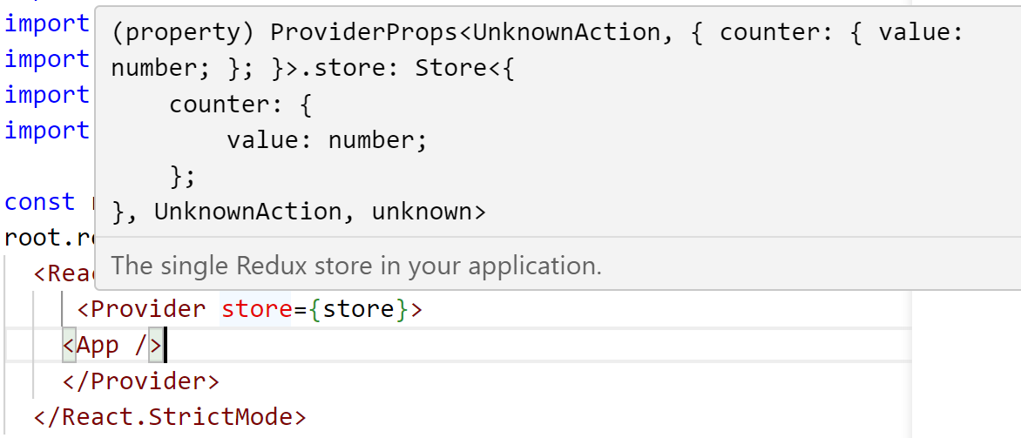
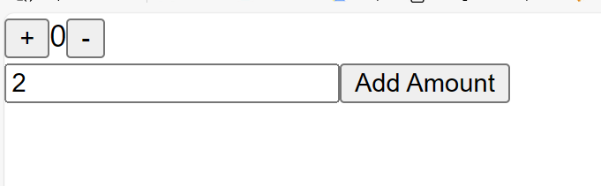
Your application start from index.js so here store is props holding value of counter which will be given to nested component with the help of provider component
<Provider store={store}>
<App />
</Provider>
Then control will go in App function which is calling Counter component
When you click on + button
<button onClick={() =>dispatch(increment()) }> + </button>

Slide 7
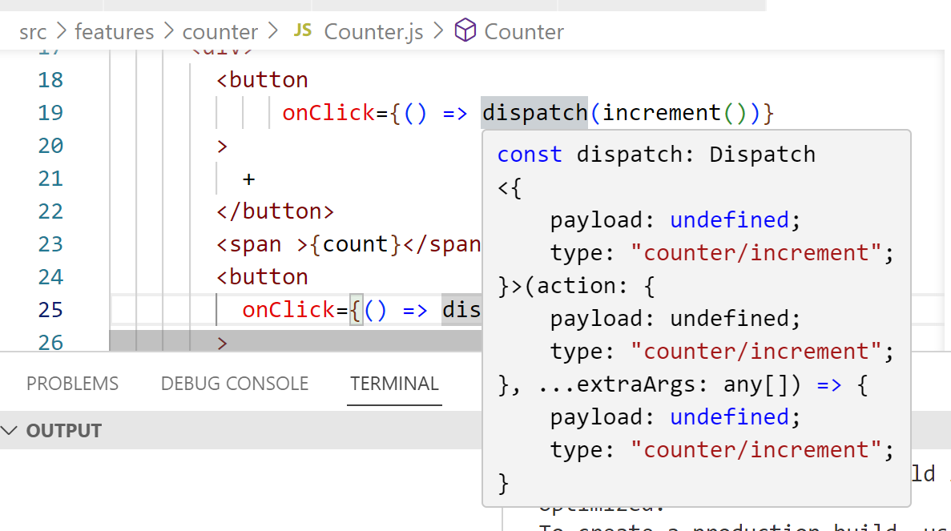
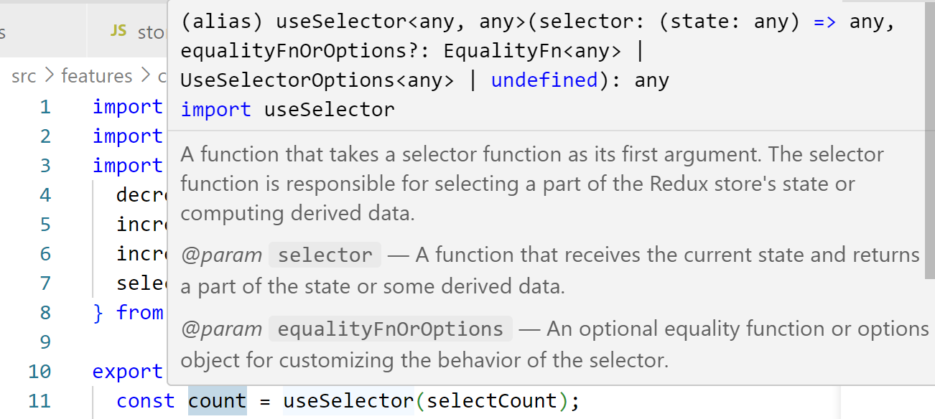
When you click on + button
<button onClick={() =>dispatch(increment()) }> + </button>
import { useSelector, useDispatch } from 'react-redux';
const count = useSelector(selectCount);
const dispatch = useDispatch();
useDispatch hook is used to call action which is point to increment function.
So here dispatch will call action and then action will increment state in store.
And then count get updated.

Slide 8
(alias) const useSelector: UseSelector<unknown> import useSelector
A hook to access the redux store's state. This hook takes a selector function as an argument. The selector is called with the store state.
This hook takes an optional equality comparison function as the second parameter that allows you to customize the way the selected state is compared to determine whether the component needs to be re-rendered.
@param selector — the selector function
@param equalityFn — the function that will be used to determine equality
@returns — the selected state
@example
import React from 'react' import { useSelector } from 'react-redux' export const CounterComponent = () => { const counter = useSelector(state => state.counter) return <div>{counter}</div> }
https://react-redux.js.org/tutorials/quick-start

